Slide 1

Colorado Republican Party
Basic Caucus and Assembly Process Overview / Preview

Slide 2
Dave Williams
State Chairman
Dave@cologop.org
Hope Scheppelman
State Vice Chairwoman
Hope@cologop.org
Anna Ferguson
State Secretary
Anna@cologop.org

Slide 3
The 2024 Elections
Presidential Election
8 Congressional Districts
State Board of Education| Dist. 2, 3, 4 & 8
CU Regent | Dist. 3, & 5
State Senate| Dist. 2, 5, 6, 10, 12, 13, 14, 16, 17, 18, 19, 21, 23, 26, 28, 29, 31, & 33
State House | Dist. 1 - 65
District Attorney | Dist. 1 - 22

Slide 4

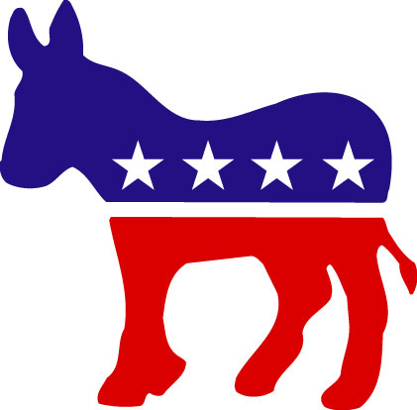
Political Party Organization
- The principal function of a Political Party is to nominate partisan candidates to the ballot, and to help get those candidates elected to office.
- Statewide
- Congressional District
- State Senate and State House
- Judicial District
- County

Slide 5
Elections and Political Parties are Governed by State and Federal Law:
- Federal Election and Campaign Finance Laws :
Federal Election Campaign Act of 1971, as amended
Regulations issued by the Federal Election Commission (FEC)
- Colorado Election Laws :
Title 1 – State and County Elections
Title 31 – Municipal Elections
Rules issued by Colorado Secretary of State
- State Campaign Finance Laws :
Colorado Constitution Article XXVIII, adopted 2002
Colorado Fair Campaign Practices Act, CRS 1-45-101
Rules issued by Colorado Secretary of State
- Home Rule Jurisdictions :
County and Municipal Charter Provisions / Ordinances
Notes:
5

Slide 6
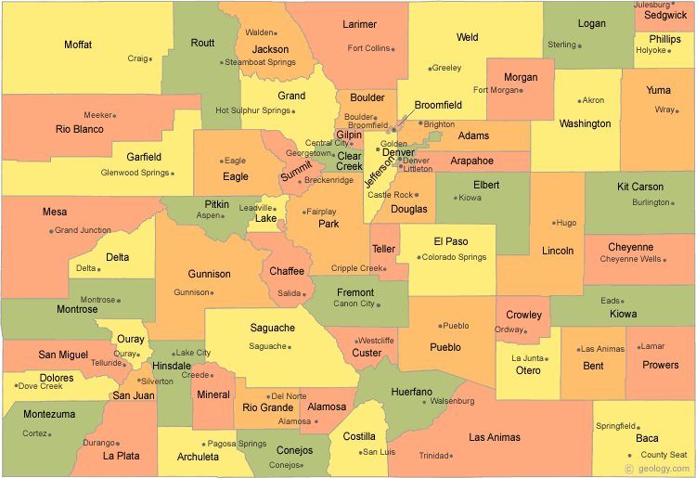
Counties in Colorado

Slide 7
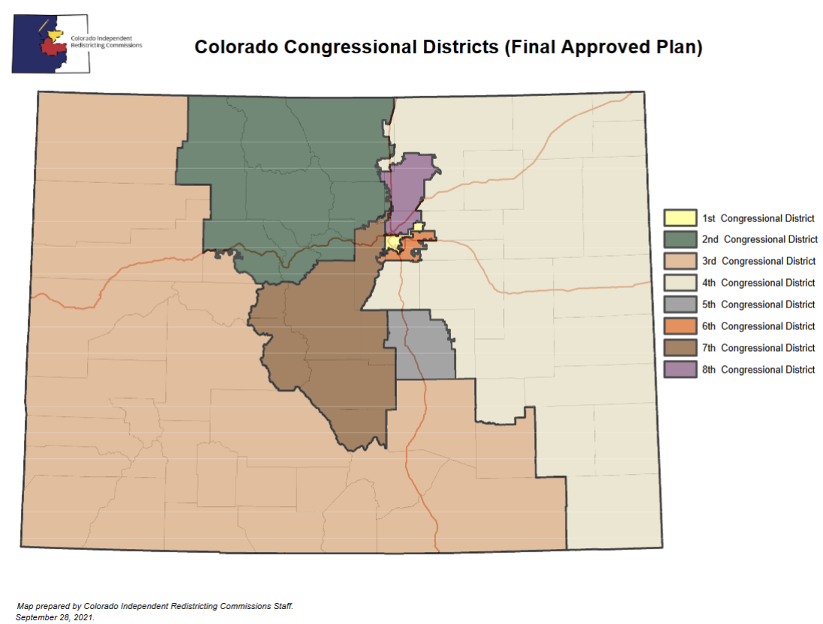
Congressional Districts in Colorado

Slide 8
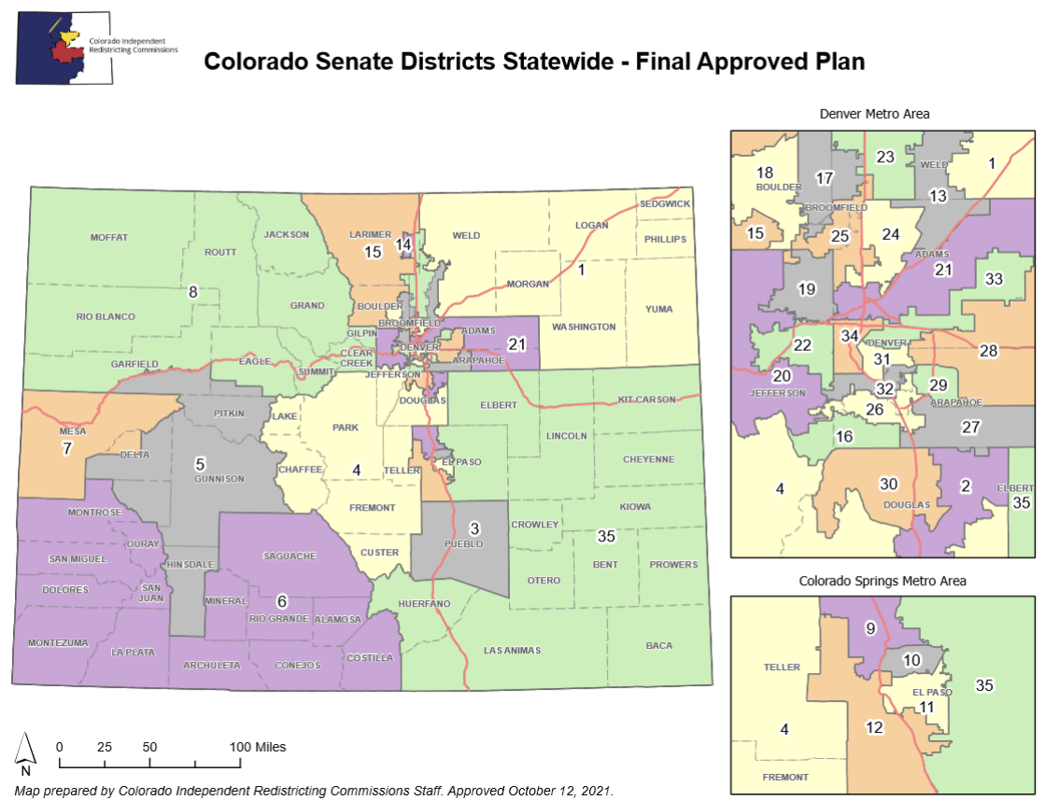
Colorado State Senate Districts

Slide 9
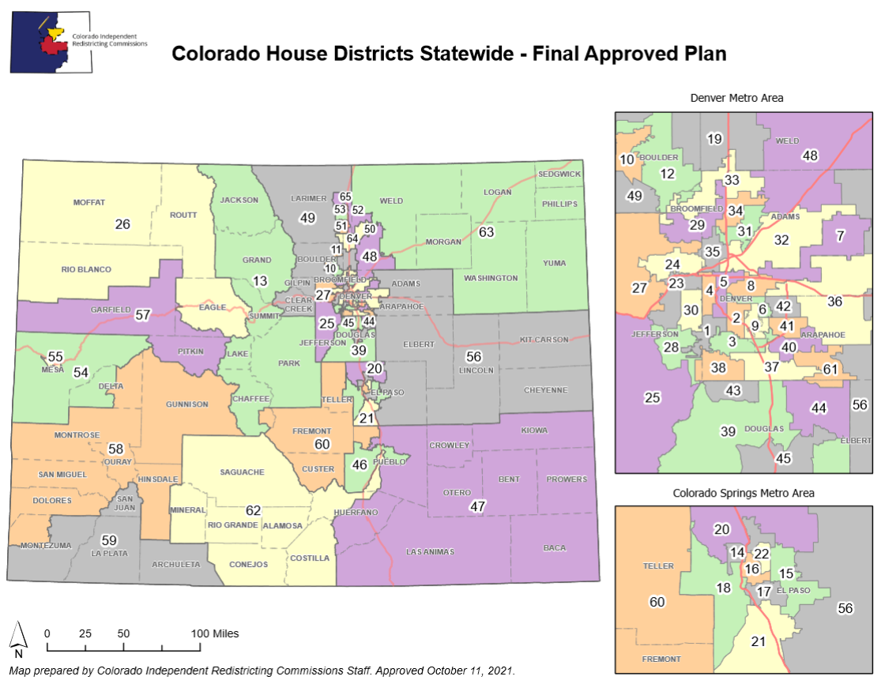
Colorado State House Districts

Slide 10
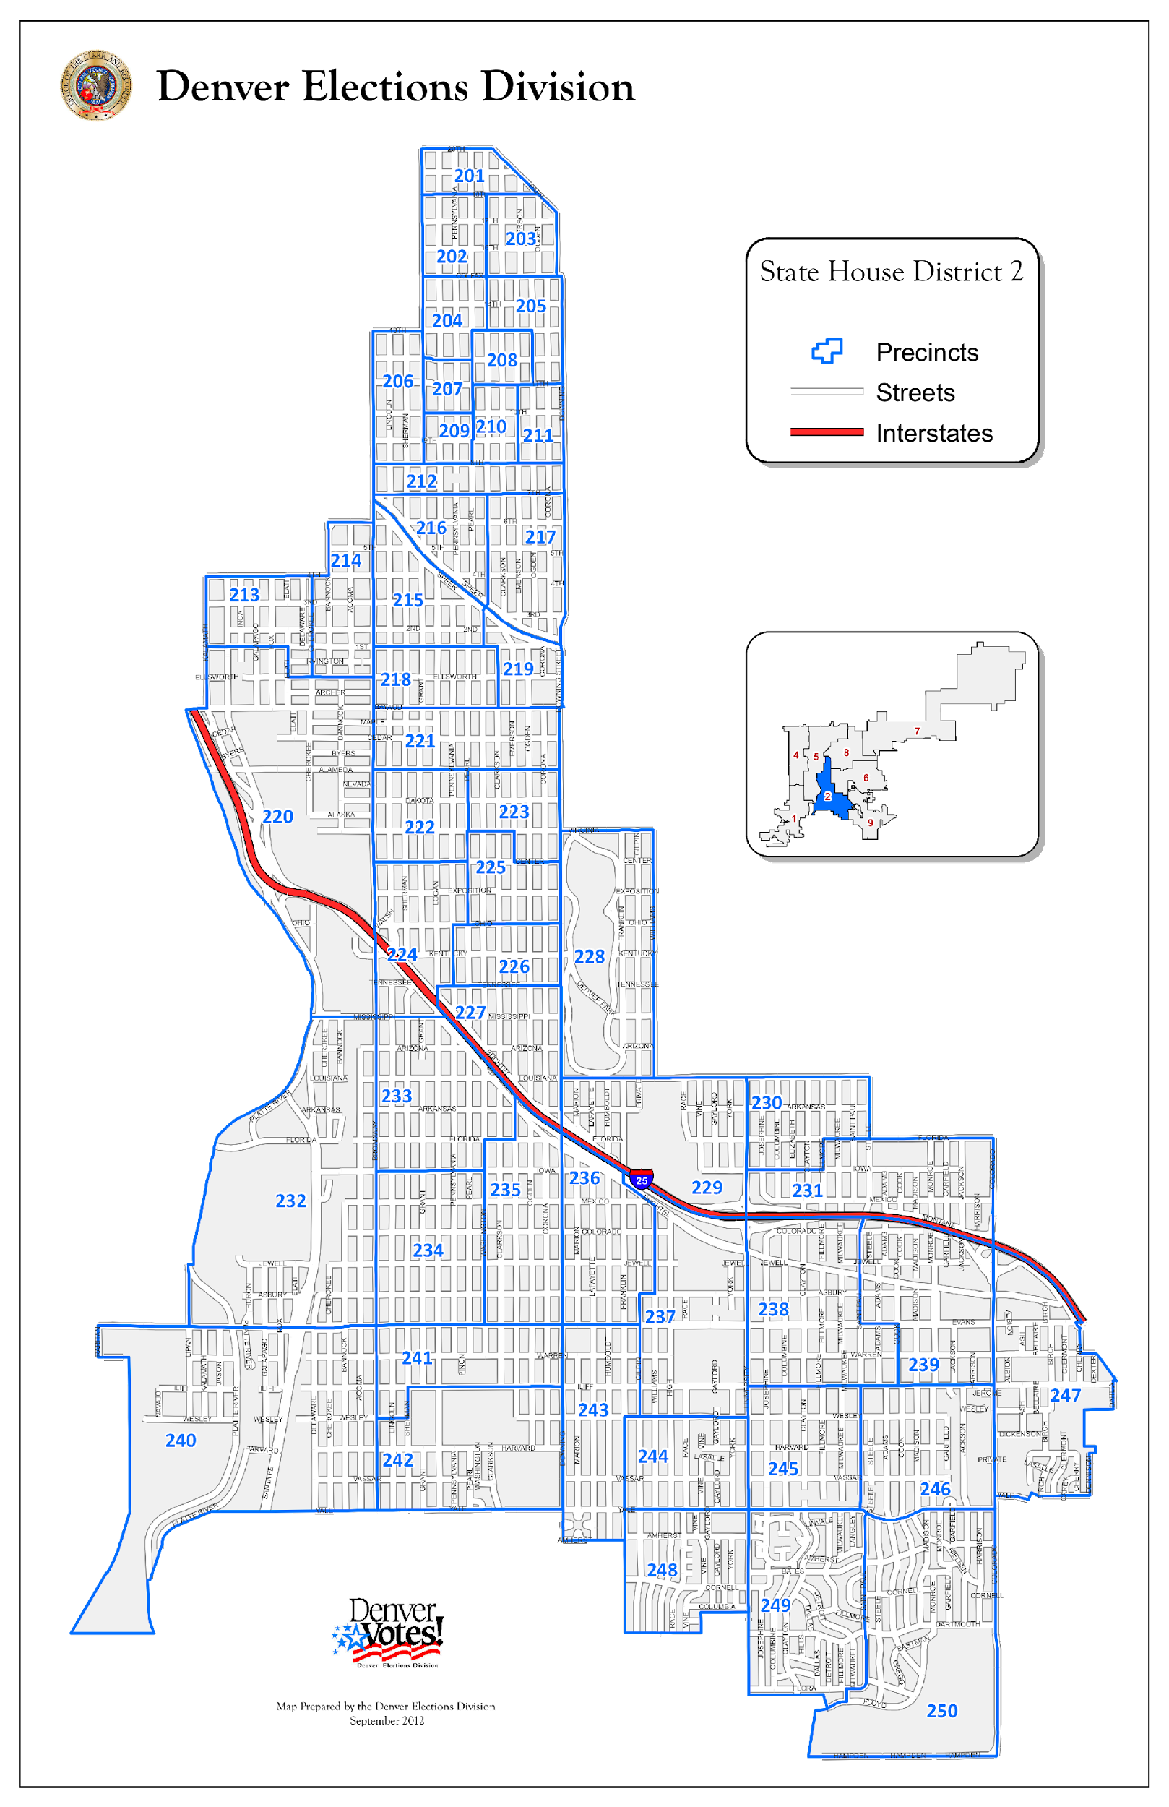
Precincts
Within a
Legislative
District:

Slide 11
County Republican Party Organization:
County Party Central Committee is comprised of precinct committeepersons, district captains, county party officers, Republican elected officials, and other voting and non-voting members as specified in county party bylaws and the rules of the Republican Party.

Slide 12
Precinct Committeeperson
“The most influential political office in the world.”
A good Precinct Committeeperson will:
- Regularly attend GOP District Meetings
- Regularly attend Community Meetings
- Conduct Neighborhood Canvass
- Organize Voter Registration Efforts
- Distribute Candidate Literature
- Coordinate Get Out the Vote Efforts
- Help Build and Grow the Party

Slide 13
Review: Purpose of Political Parties
- The principal function of a Political Party is to nominate partisan candidates to the ballot, and to help get those candidates elected to office.
- Statewide
- Congressional District
- State Senate and State House
- Judicial District
- County

Slide 14
Candidate Ballot Access:
Under Colorado law, there are two ways for a partisan candidate to gain access to the primary election ballot for state, county and district offices:
- Designation to the Primary Ballot by Assembly
- Designation to the Primary Ballot by Petition
Non-partisan and local offices gain access to the ballot by petition only, in accordance with municipal election code, local charter or home rule ordinance.

Slide 15
Candidate Ballot Access Terminology:
Candidates are DESIGNATED to the Primary Election Ballot by Assembly or by Petition.
Candidates are NOMINATED by Primary Election (i.e. they become the Republican Party’s NOMINEE by winning the Primary Election)
Until a Republican nominee is chosen by the Republican voters, the Republican Party as an organization and its officers maintain neutrality in contested primary elections.

Slide 16
Primary Ballot Access by Petition:
First day to circulate major party petitions for primary ballot designation: Tuesday, January 16th, 2024
[CRS 1-4-801(5)].
Last day to file major party petitions for primary ballot designation: by Tuesday, March 19th, 2024
[No later than 85 days before the primary election, CRS 1-4-801(5)(a)].

Slide 17
Precinct Caucuses begin the process of ballot designation by party assembly:
Thursday, March 7th, 2024
or
Saturday, March 9th, 2024
caucus.cologop.org

Slide 18
Principal Business of the Caucus:
Elect Precinct Committeepersons
Elect Delegates/Alternates:
  To County Assembly (and Single-County Assemblies)
  Depending on County Party Rules, delegates may be apportioned to individual precincts for multi-county Judicial/House/Senate Assemblies, Congressional Assembly, and State Assembly – however, any delegates selected at precinct caucus must be ratified at the County Assembly.

Slide 19
Example Precinct Caucus Agenda:
Welcome and Call to Order
Invocation / Pledge
Candidate Support Speeches
Select temporary precinct caucus chair and secretary
Elect Precinct Committeepersons by secret ballot or raise of hands, tally and announce results
Elect Delegates/Alternates to County Assembly (and, if applicable, to other multi-county higher assemblies – BUT ONLY IF delegates have been apportioned to the precinct by County Party rules)
Recruit Election Judges
Discuss Issues and Consider Resolutions to pass to County Party Assembly
Adjourn and Complete Paperwork for County Party

Slide 20
Precinct Caucus Q and A:
Q - Who is eligible to participate in precinct caucuses?
A – All registered Republican voters:
  Who have lived in the precinct for at least 22 days (Friday, February 16th 2024);
  Who have been registered to vote no later than 22 days before the caucus (Friday, February 16th 2024);
  Who have been affiliated with the Republican Party for at least 22 days (Friday, February 16th 2024).
  Anyone who turns 18 or becomes a naturalized citizen less than 22 days before the caucus may participate
  A preregistrant who is 17yrs of age at the caucus but will be 18yrs on the date of the next general election
  NO VOTING BY PROXY OR ABSENTEE PERMITTED AT CAUCUS

Slide 21
Precinct Caucus Q and A:
Q – How are Precinct Caucus locations determined?
A – Each County Party Executive Committee OR Central Committee MUST authorize or approve locations for the Precinct Caucuses to be held within the county.
Joint caucus locations are acceptable and encouraged, and all caucus locations MUST be ADA accessible.
Once CAUCUS locations are identified, all locations must be entered into the CRCAS system (Caucus management system) for online sign ups.

Slide 22
Precinct Caucus Q and A:
Q – What are the Notice and Publication requirements?
A – Each County Party MUST post a prominently displayed notice sign at the location of each precinct caucus at least twelve (12) days (February 26, 2024) before the caucus. [ CRS 1-4-602 (4)]
The sign shall be substantially in the following form:
"Precinct caucus place for precinct no. ......"
The lettering on the sign and the precinct number shall be black on a white background with all letters and numerals at least four inches in height. Any precinct caucus subsequently removed and held in a place other than the place stated on the sign is null and void.”

Slide 23
Precinct Caucus Q and A
Q – How will the State Party provide help to the County Parties to run the precinct caucuses and report the results?
A – The State Party, will work with all 64 counties to understand and utilize the CRCAS caucus management online system. This system will be required by all county parties to help manage the process from precinct caucus to county assembly to higher assemblies.
The CRCAS system will auto generate your precinct caucus sign in sheets, your scripts, your reporting forms, and full voter lists of eligible participants.

Slide 24
Preparation for the Caucus:
Adopt County Delegate Apportionment formula/plan (based on 2018 TO or registered R’s)
Determine number of delegates to be selected from each precinct and determine if delegates to higher assemblies will be apportioned to precinct caucuses.
Determine and formally approve ALL precinct caucus locations and corresponding precincts, and arrange for sign postings
Prepare/ print copies of Precinct Caucus Packets, Reporting Forms from the CRCAS system
Prepare and distribute materials from CRCAS system for Precinct Caucus to precinct committeepersons and/or district captains
Implement Precinct Caucus promotion plan

Slide 25
Then What?
Delegates selected at the Precinct Caucus will then attend County and District Assemblies:
  County Assembly, all Single-County Assemblies
    No earlier than March 7 ^{th} (after precinct caucus takes place and no later than March 30^{th)}
  Judicial District Assemblies
  Senate and House District Assemblies
  Congressional District Assembly (between April 4th and April 5th 2024)
  State Assembly (Saturday – April 6th, 2024)

Slide 26
Candidate Eligibility:
Candidates are responsible for ensuring they satisfy all necessary eligibility requirements pertaining to office, including registration, residency and party affiliation status.
Last day to affiliate with a major party in order to run as a party candidate in the primary (either by petition or assembly) January 2nd , 2024
Political Party Central Committee officers should independently verify relevant candidate eligibility found in the records of the County Clerk or Secretary of State prior to the assembly.

Slide 27
County Assembly (and single-county assemblies)
No later than March 30th, 2024 (not later than 21 days after the precinct caucuses; CRS 1-4-602(1)(a)(1))
HOWEVER: CRC is strongly requesting ALL county assemblies conclude by March 29, 2024
Designation of County Candidates to the Republican Primary Election Ballot – County candidates designation & acceptances must be filed no later than 4 days after the adjournment of county assembly
Candidate speeches
Election or Ratification of Selection of Delegates/Alternates to Higher Legislative District Assemblies
Election of Congressional Assembly Delegates/Alternates
Election of State Assembly Delegates/Alternates
Adoption of County Party Platform Resolutions

Slide 28
Single-County District Assemblies
MUST be held THE SAME DAY as the county assembly; same as delegates/alternates to county assembly
Designation of District Candidates to the Republican Primary Election Ballot – House/Senate, County Commissioners ONLY if elected by district
Designation of Vacancy Committees:
  Vacancy in Central Committee membership
  Vacancy in Designation or Nomination
  Vacancy in Elective Office (if applicable)

Slide 29
Multi-County District Assemblies
MUST be held AFTER all applicable county assemblies but before State Assembly, no later than April 5, 2024.
Designation of District Candidates to the Republican Primary Election Ballot – House/Senate
Designation of Vacancy Committees:
  Vacancy in Central Committee membership
  Vacancy in Designation or Nomination
  Vacancy in Elective Office (if applicable)

Slide 30
Congressional District Assemblies
March 23rd – April 5th , 2024
(no earlier than 14 days before State Assembly).
Designation of District Candidates to the Republican Primary Election Ballot:
  Congressional Candidate, State Board of Education, CU Regents
National Delegates to RNC National Convention
Designation of Vacancy Committees:
  Vacancy in Central Committee membership
  Vacancy in Designation or Nomination
  Vacancy in Elective Office NOT APPLICABLE

Slide 31
State Republican Assembly
Saturday, April 6th , 2024 – Colorado State Fairgrounds | Pueblo
Designation of Statewide Candidates to the Republican Primary Election Ballot:
  US House Representative
  National Committeeman
  National Committeewoman
  National Delegates to RNC Convention
Adoption of Party Platform Resolutions

Slide 32
Primary Election Day:
Tuesday, June 25th, 2024
General Election Day:
Tuesday, November 5th, 2024
Presidential Preference Primary
Tuesday, March 5th, 2024

Slide 33
Questions and Discussion

Slide 34
www.cologop.org
Caucus Locations & Pre-registration: caucus.cologop.org

